Slide 1

TikTok User Engagement Data
Niku Kumari Jawahar Chowdari

Slide 2
Content
Introduction & Problem Statement
Motivation & Goals
Literature Review
Research Questions
Methodology
Results
Conclusion
Limitation & Future Work
References

Slide 3
Introduction & Problem Statement
WHY TIKTOK?
Innovative short-form video format
Expansive user base driving cultural influence
Shaping perceptions and redefining entertainment
Insights into contemporary digital behavior
PROBLEM STATEMENT
Understanding TikTok's influence on entertainment and culture.
Identifying factors driving user engagement.
Lack of insights hindering effective engagement strategies.
Need for comprehensive understanding for content creators and marketers.

Slide 4
Motivation & Goals
Define your goals: Do you want to increase brand awareness, drive sales, or build a community?
Tailor your content: Understanding your goals helps you create content that resonates with your target audience and encourages interaction.
- For Instance: Chipotle- #boorito campaign
Track your progress: Monitor your engagement metrics to see what's working and what needs improvement.

Slide 5
Literature Review
TikTok as a Platform for Marketing Campaigns: The effect of Brand Awareness and Brand Recall on the Purchase Intentions of Millennials
The impact of social media marketing on purchase intention: The mediating role of brand trust and image
The Impact of TikTok User Satisfaction on Continuous Intention to Use the Application
How Brands Go Viral: An Analysis of Successful Brand Marketing on Tik Tok with Gen Z

Slide 6
Research Questions
Does having a verified video lead to more success of the video? (Success is defined by high number of likes, shares and comments)
Does having more views mean that the video is successful?
Are there differences in engagement between videos labeled as 'claim' versus 'opinion'?
To discover hidden patterns and insights to enhance our understanding of user behavior by using content-based network analysis.

Slide 7
METHODOLOGY
Dataset: TikTok Dataset
- Dataset Size: 19,000 records
- Variables: #ID, Claim Status, Video ID, Video Duration Sec, Video Transcription Text, Verified Status, Author Ban Status, Video View Count, Video Like Count, Video Share Count, Video Download Count, Video Comment Count
Tools Used – Python, Jupyter Notebook, Gephi
Data Preprocessing – Python
- Data Cleaning, Feature Selection
Exploratory Data Analysis – Python
Sentiment Analysis - Python
Social Network Analysis – Gephi
- Utilizing Python NLTK, employed bigrams to create two columns from the data, enabling automated processing of nodes and edges for Gephi input.

Slide 8
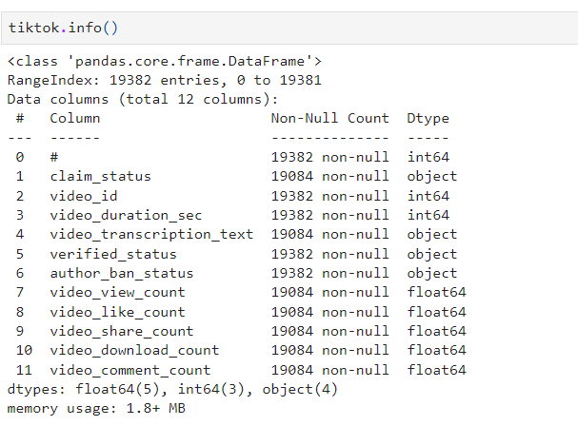
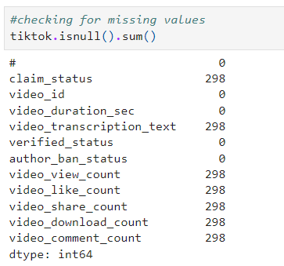
About Data:
Data Information
Checking for null values

Slide 9
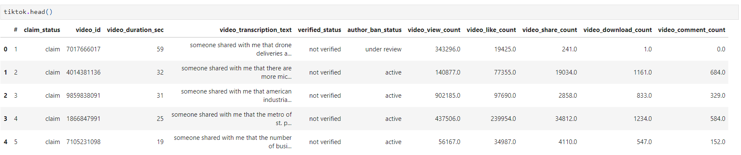
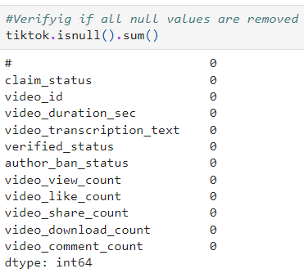
Data Cleaning:
Data Before Cleaning
Data after handling null values

Slide 10
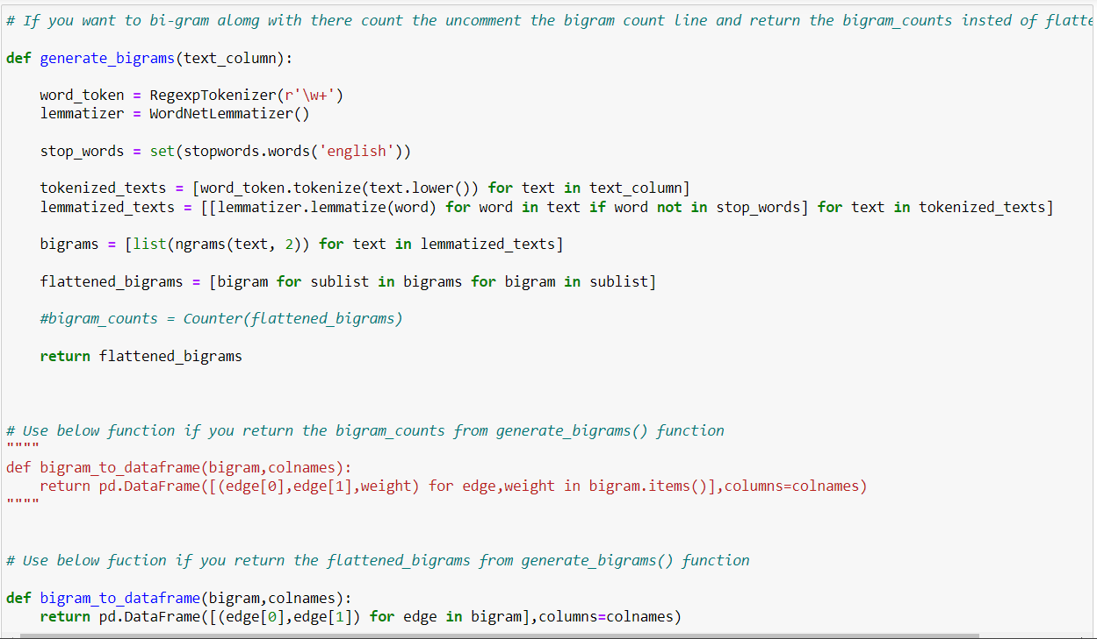
Data Preprocessing:
Bigrams to create two columns for automated processing of nodes and edges in Gephi

Slide 11
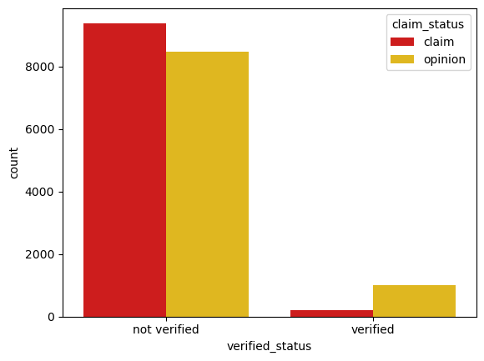
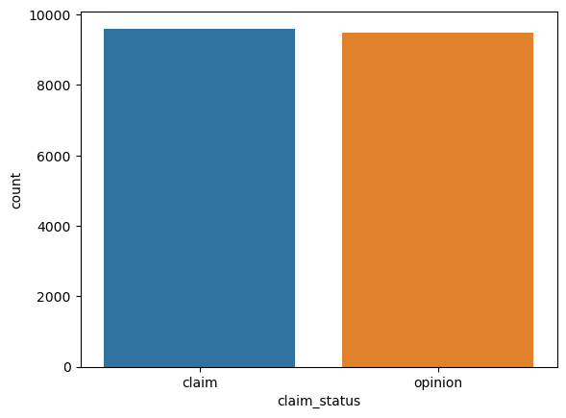
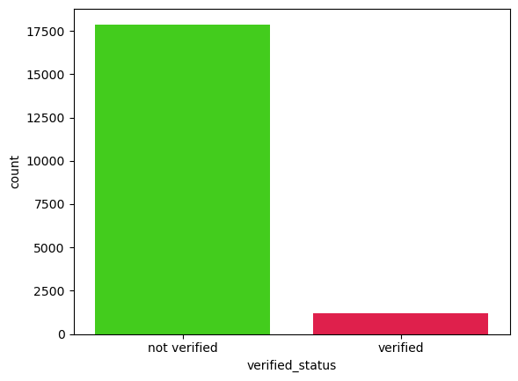
Exploratory Data Analysis
The below graphs displays the count of different categorical values in our dataset.

Slide 12
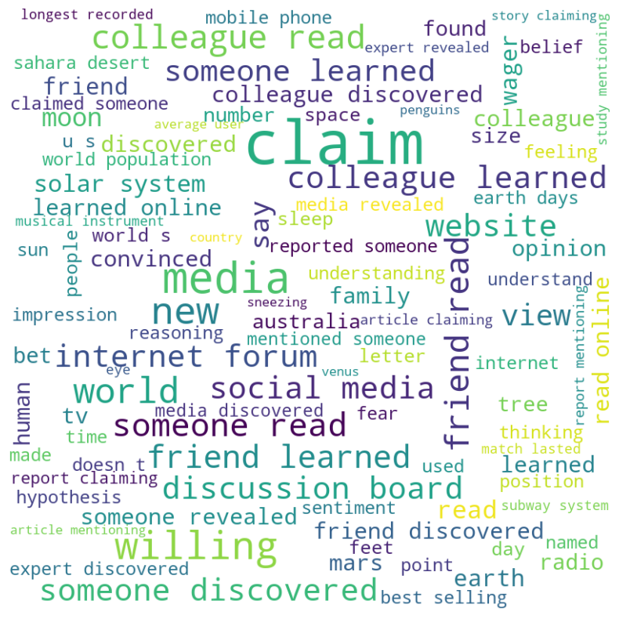
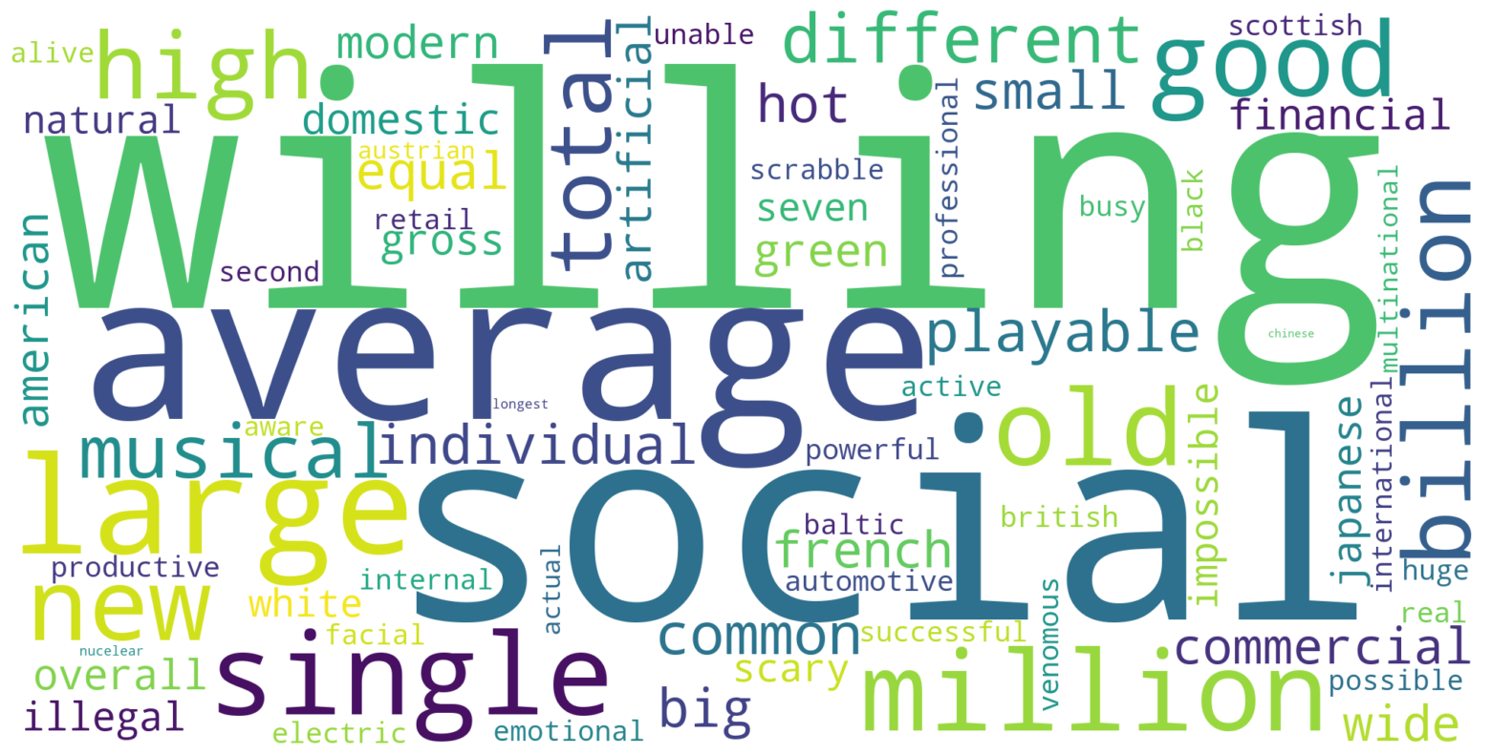
Sentiment Analysis
Word Cloud of the video transcript before data preprocessing

Slide 13
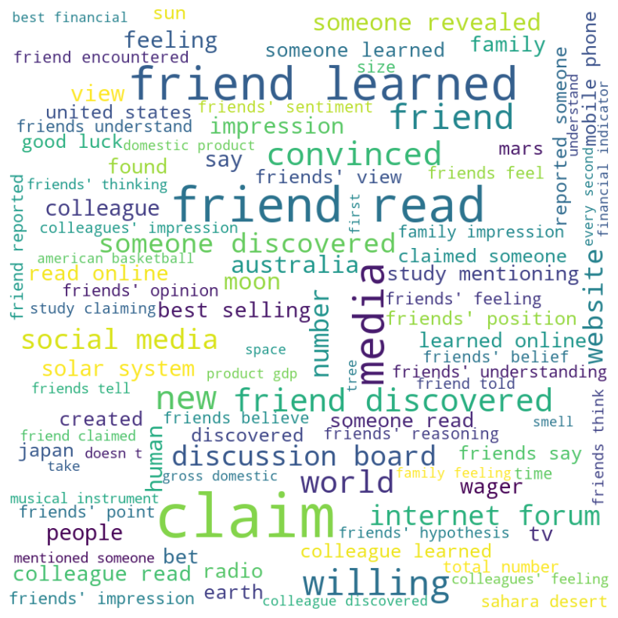
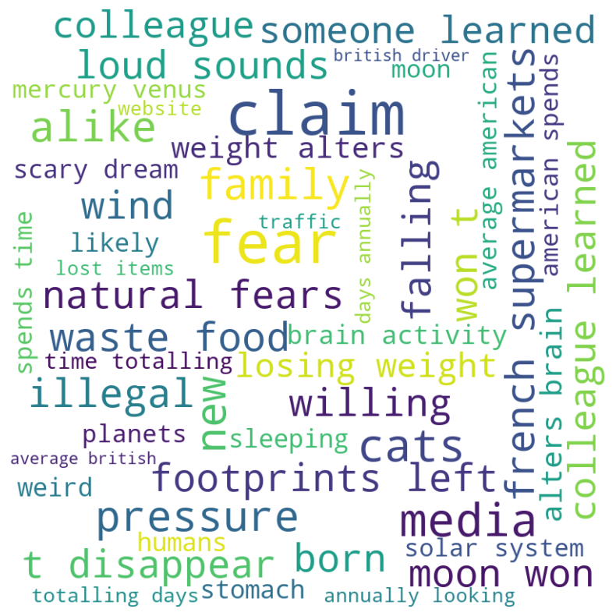
Sentiment Analysis:
Positive Sentiment
Negative Sentiment

Slide 14
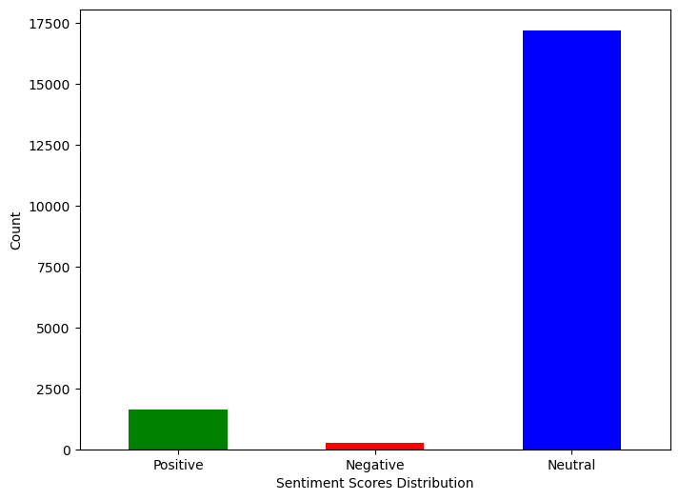
Sentiment Analysis:
Sentiment scores by their counts

Slide 15
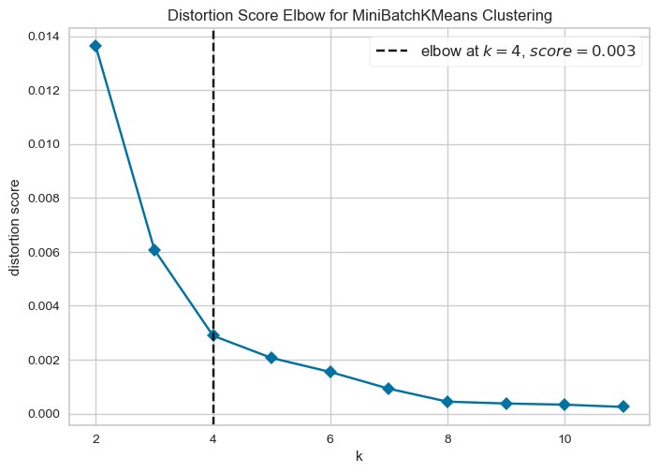
Topic Modeling:
Number of clusters can be formed in our dataset

Slide 16
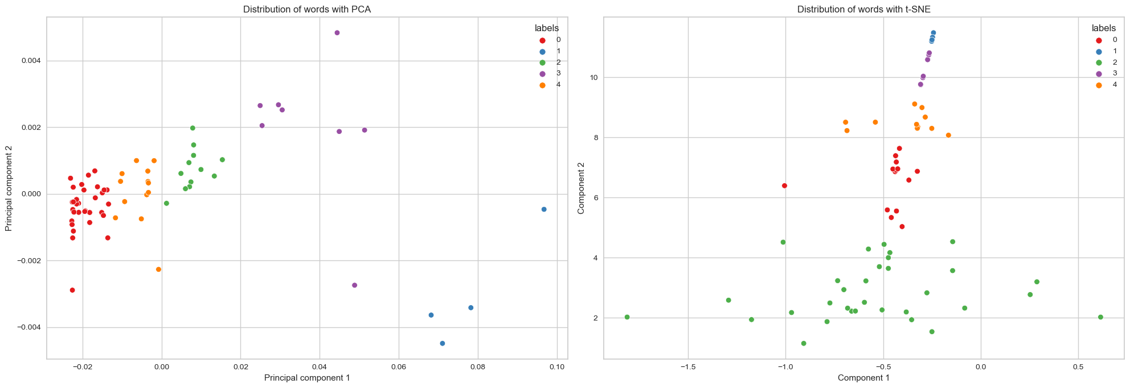
Topic Modeling:
Distribution of words with PCA and t-SNE model before dimensionality reduction.

Slide 17
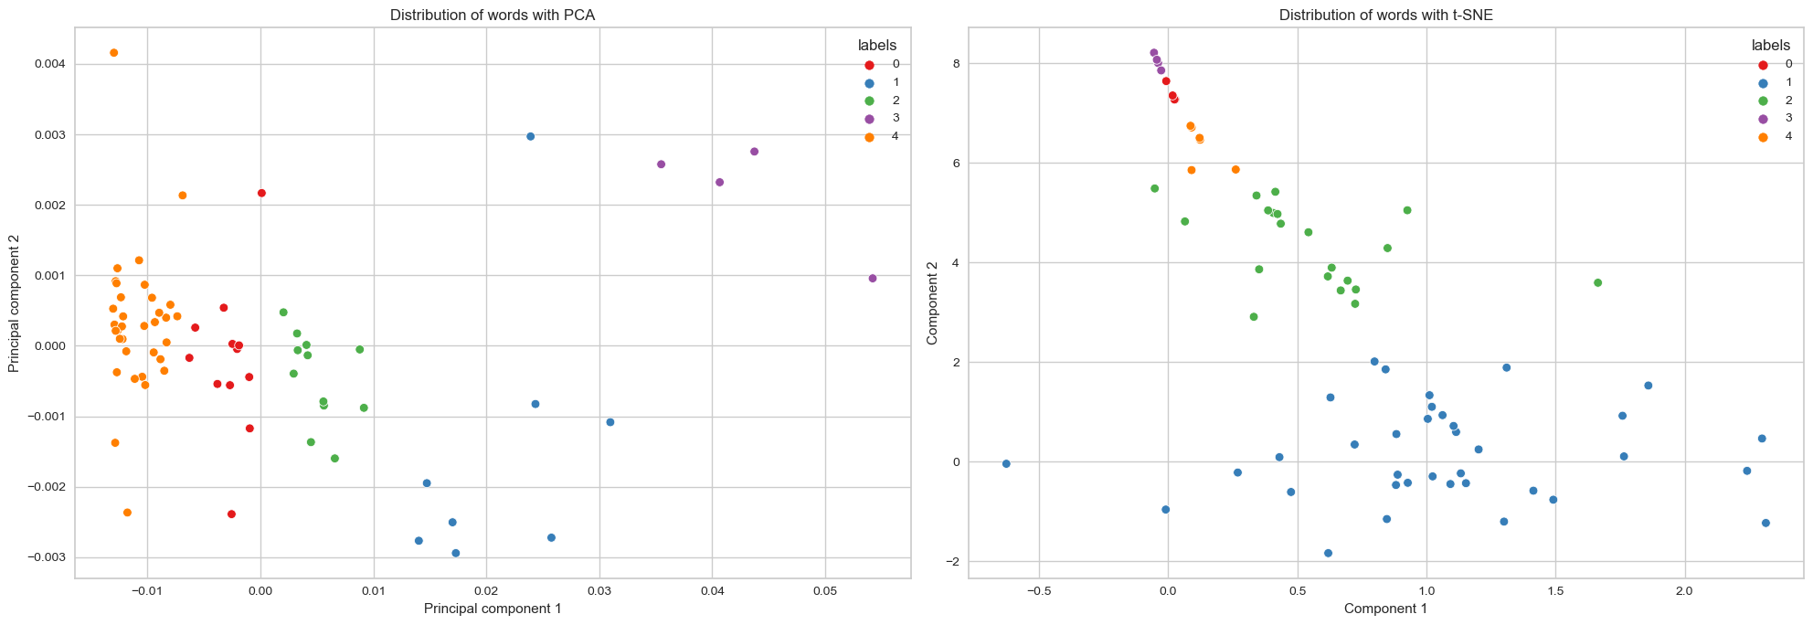
Topic Modeling:
Distribution of words with PCA and t-SNE model after dimensionality reduction.

Slide 18
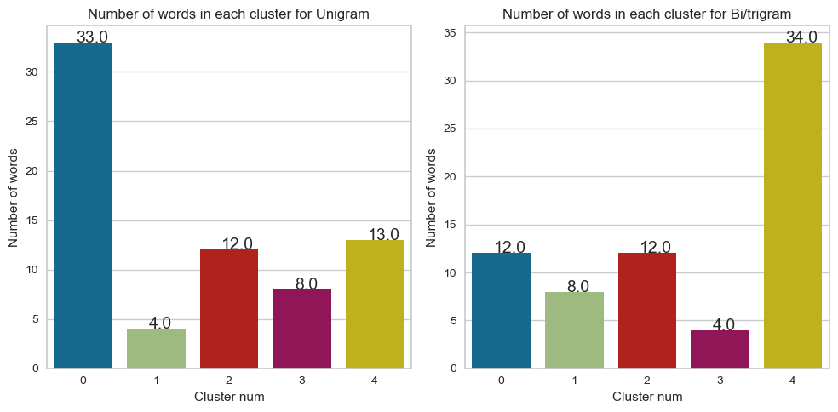
Topic Modeling:
Word Count in each cluster for Unigram and Bi/Trigram after applying PCA and K means clustering

Slide 19
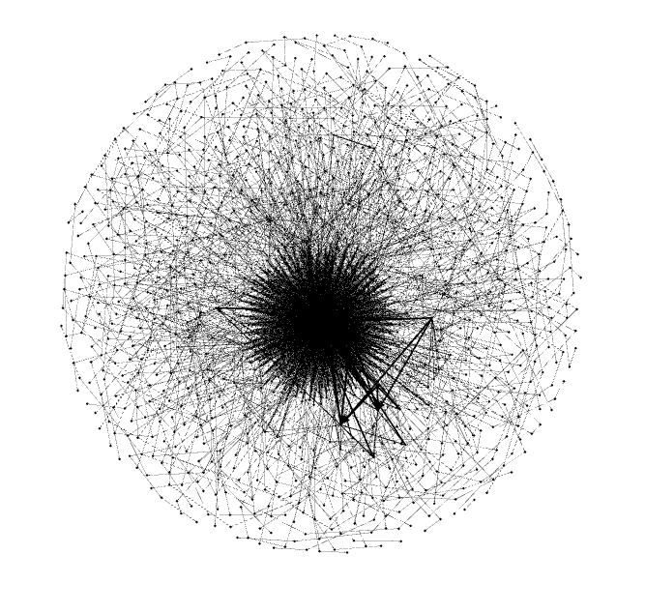
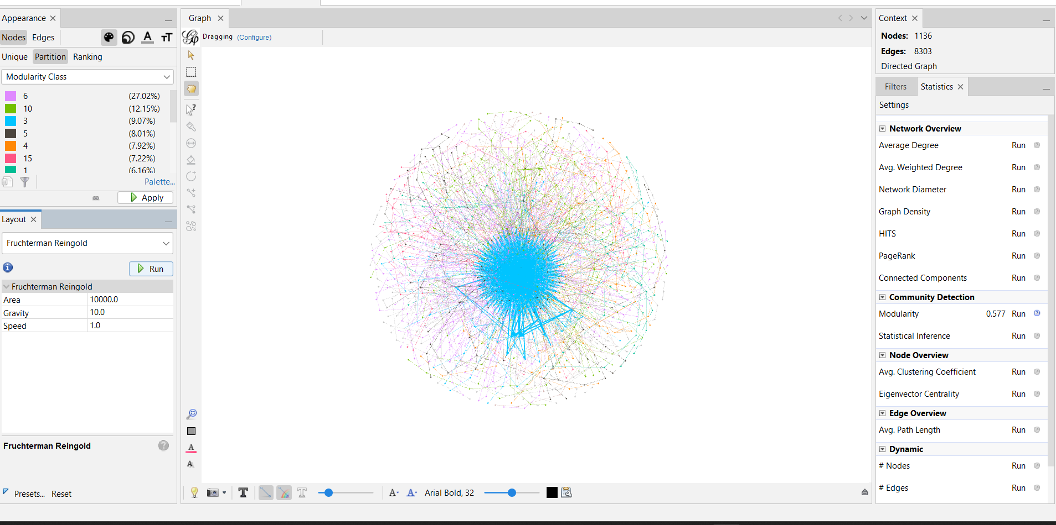
Network Analysis:
Network diagram and Modularity Class of TikTok network.

Slide 20
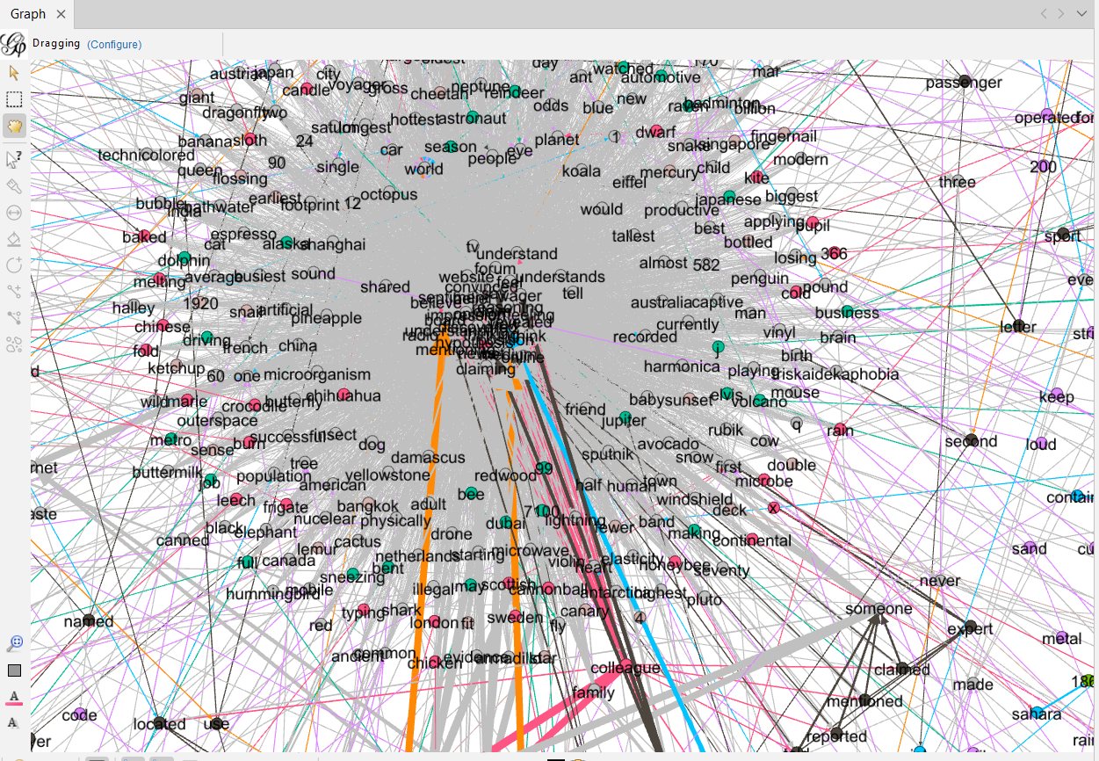
Network Analysis:
Degree Centrality of Nodes in TikTok network.

Slide 21
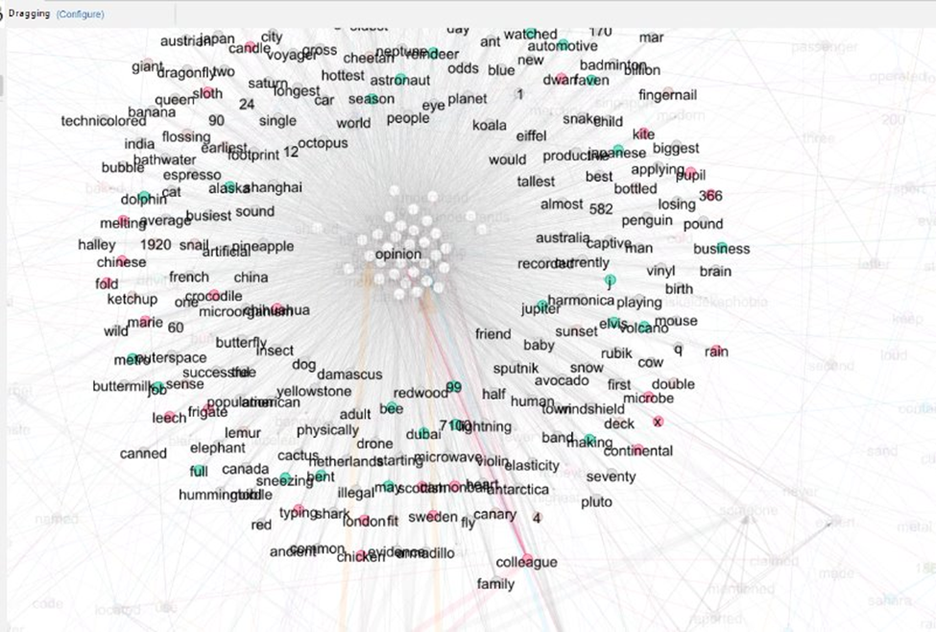
Network Analysis:
Words associated with Opinion word.

Slide 22
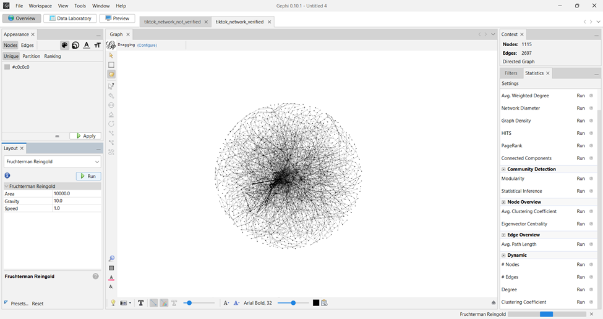
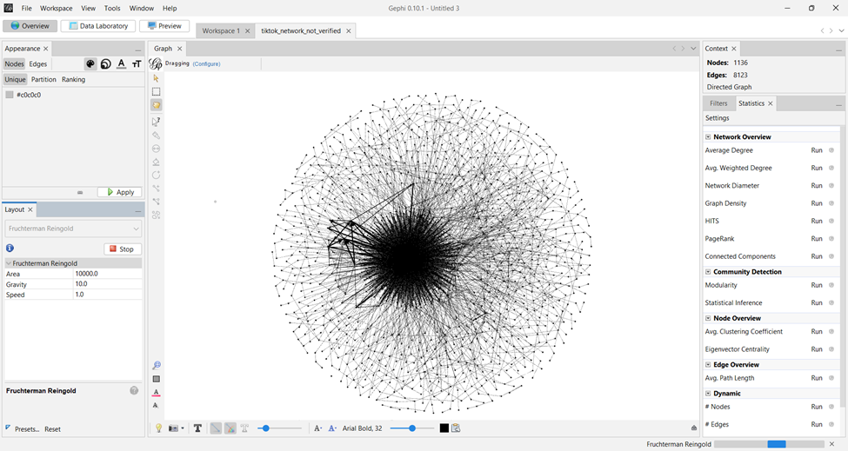
Network Diagram
Verified and Not Verified network diagrams of TikTok Dataset.

Slide 23
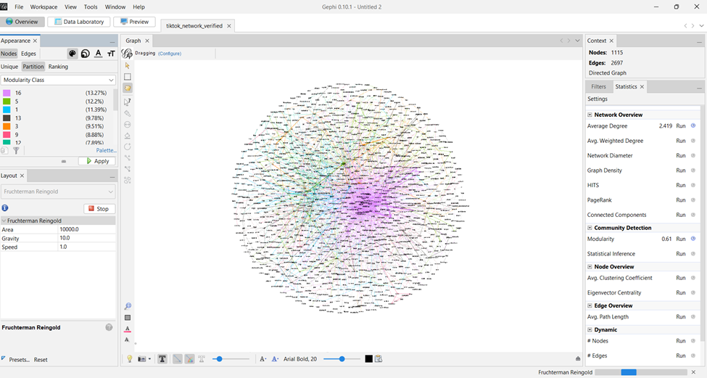
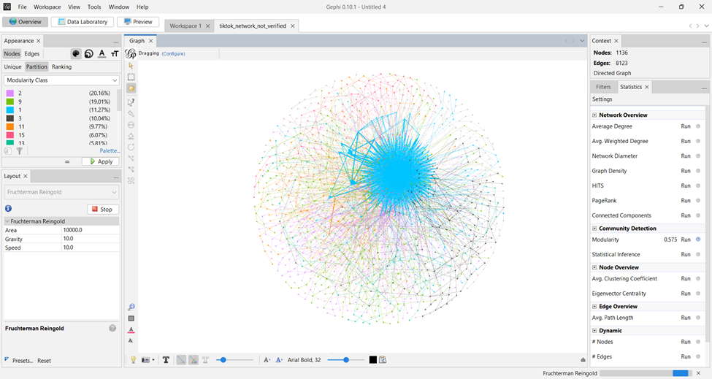
Modularity Class:
Modularity Class of Verified and Not Verified networks.

Slide 24
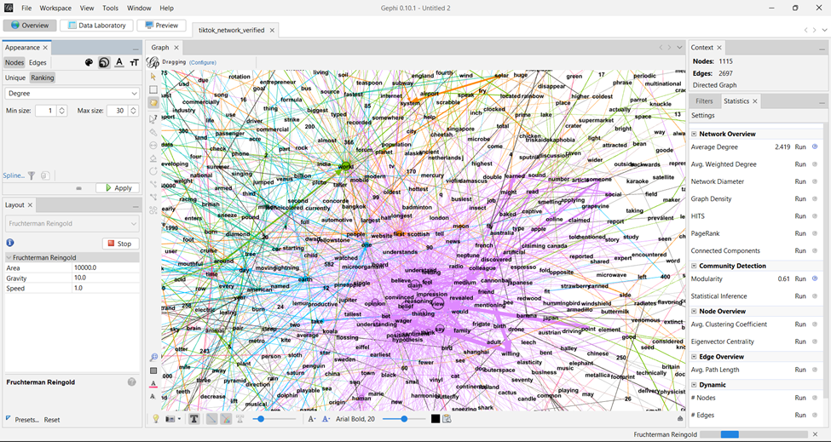
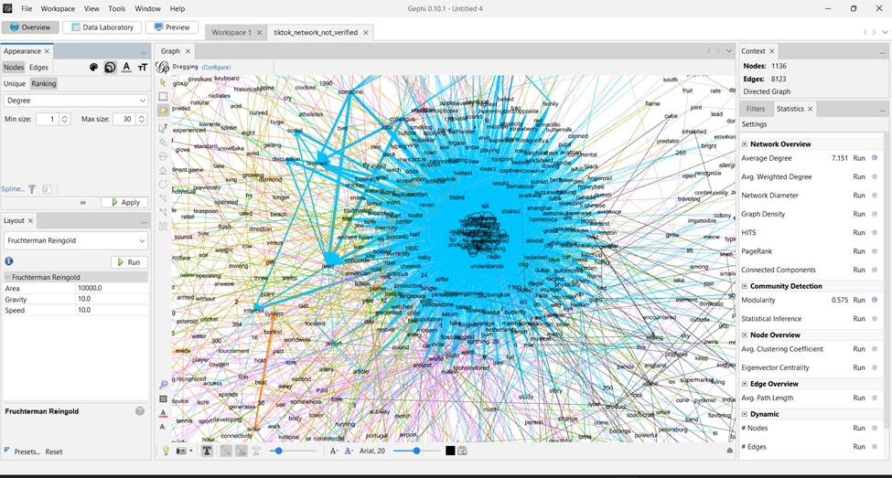
Degree Centrality:
Degree Centrality of Verified and Not Verified networks.

Slide 25
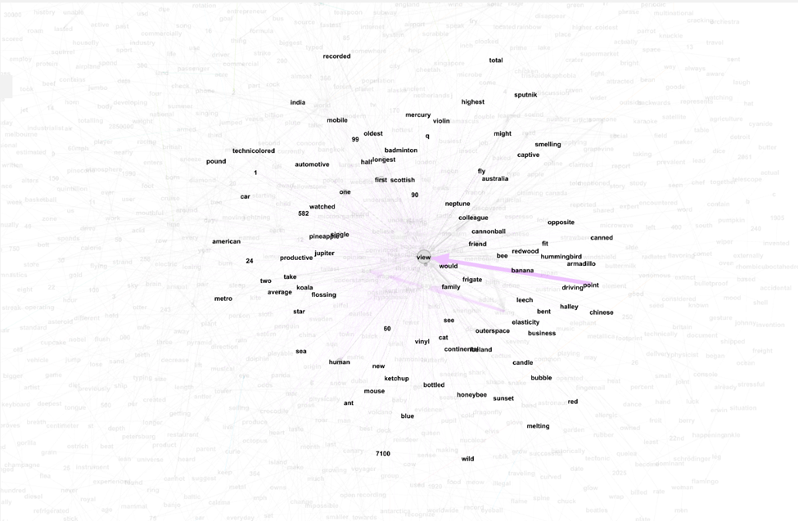
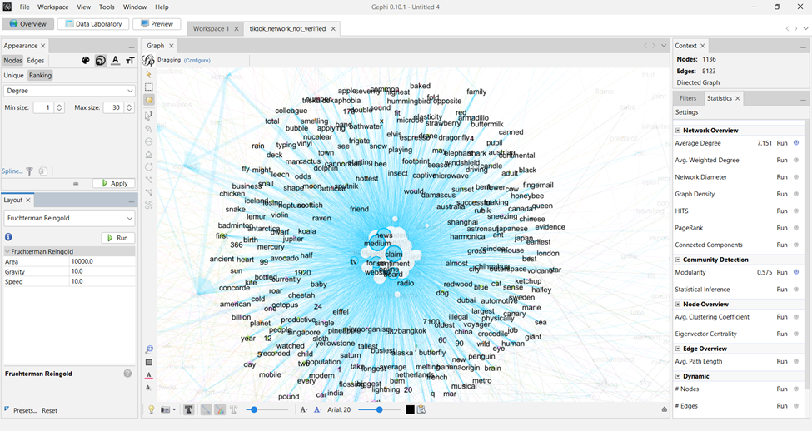
Correlated Words:
Associated words and their distribution in Verified and Not verified networks.

Slide 26
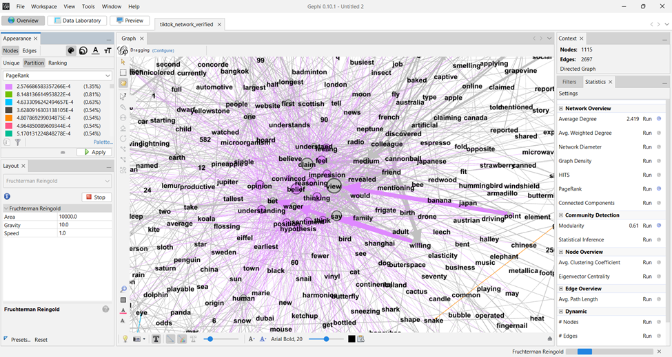
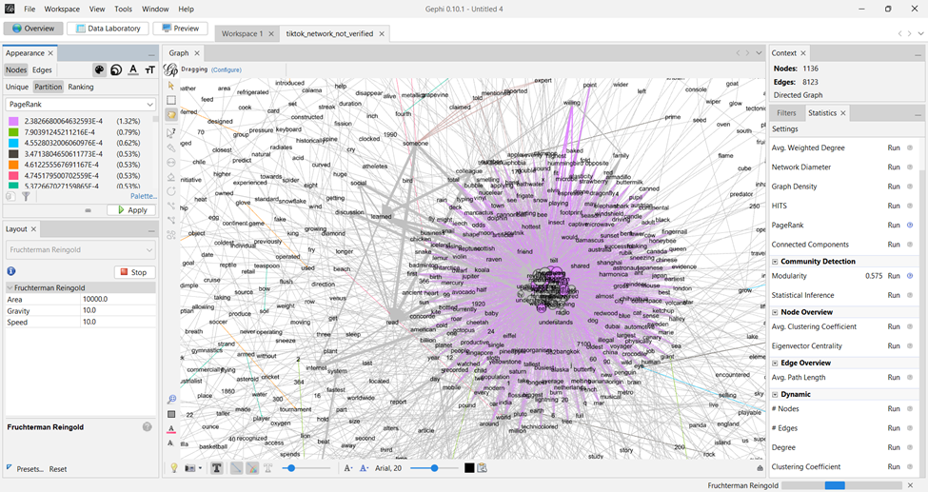
Page Rank:
Page Rank of Verified and Not verified networks.

Slide 27
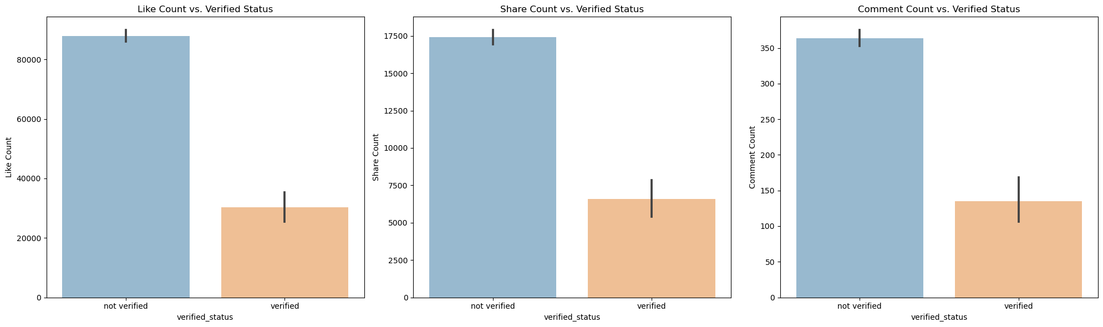
Research Questions:
Does having a verified video lead to more success of the video? (Success is defined by high number of likes, shares and comments)​

Slide 28
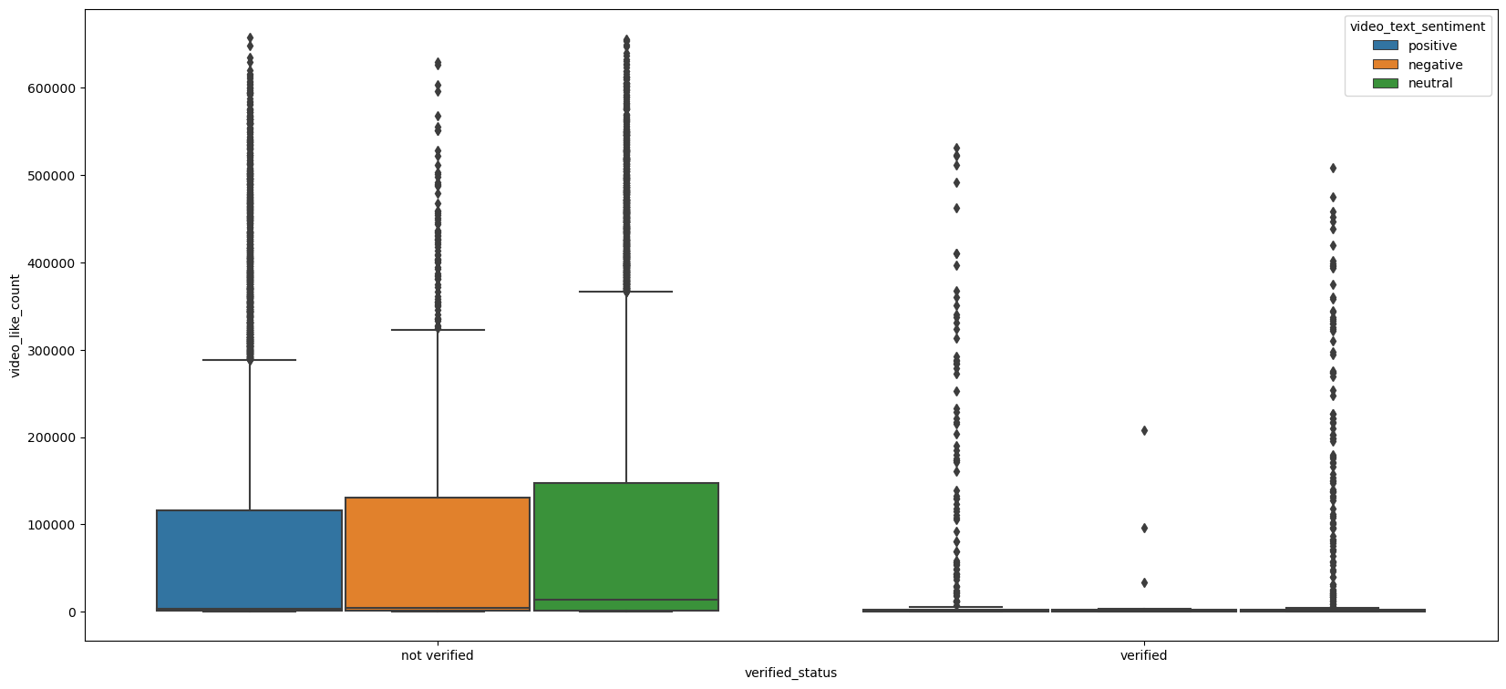
Research Questions:
Does having a verified video lead to more success of the video? (Success is defined by high number of likes, shares and comments)​
Verified Status based on text sentiment with respect to Video Like Count​

Slide 29
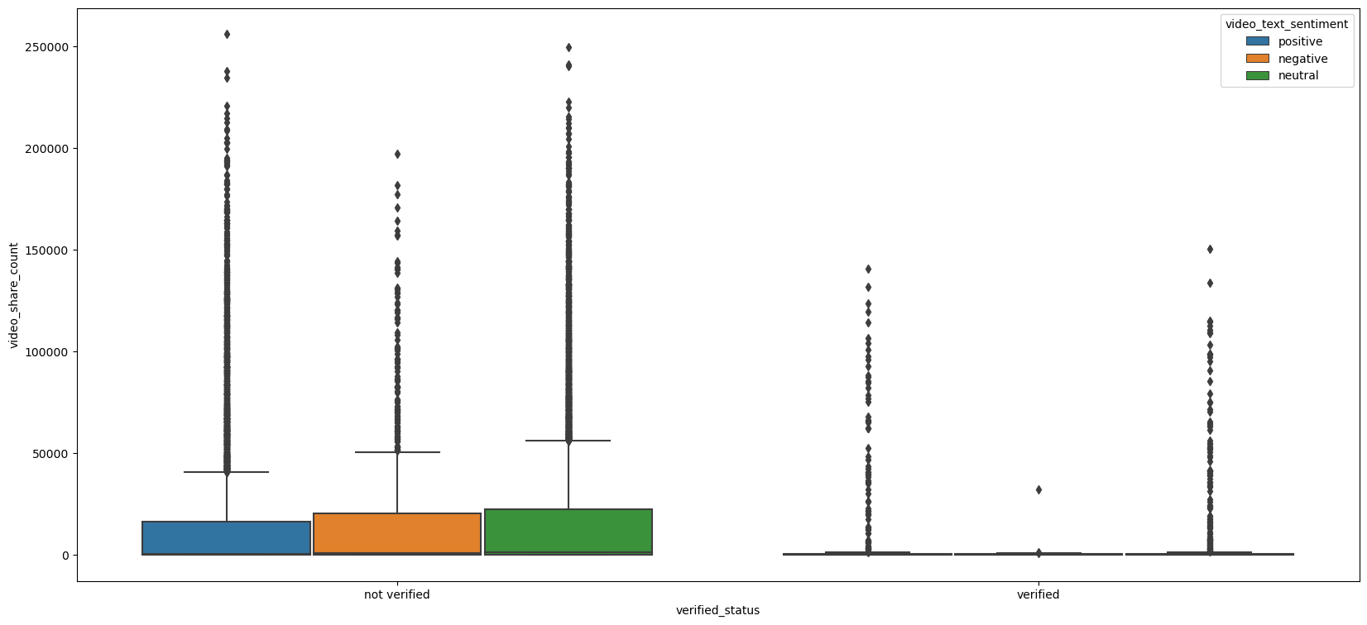
Research Questions:
Does having a verified video lead to more success of the video? (Success is defined by high number of likes, shares and comments)​
Verified Status based on text sentiment with respect to Video Share Count​​

Slide 30
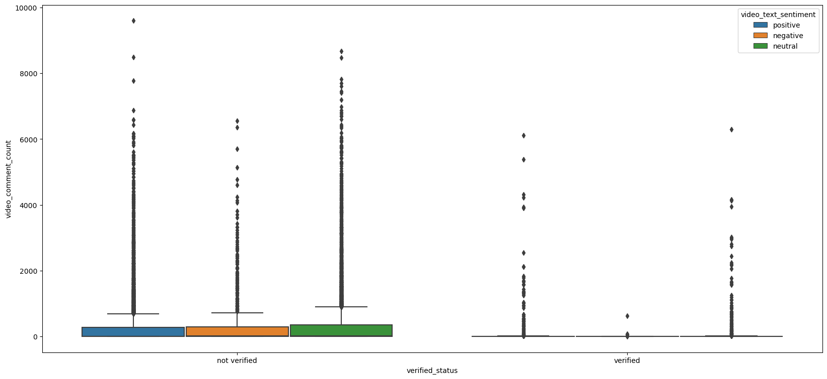
Research Questions:
Does having a verified video lead to more success of the video? (Success is defined by high number of likes, shares and comments)​
Verified Status based on text sentiment with respect to Video Comment Count​​​

Slide 31
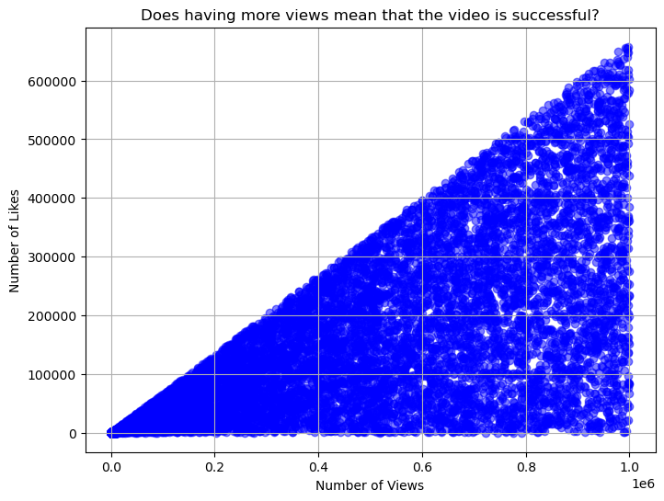
Research Question:
2. Does having more views mean that the video is successful?

Slide 32
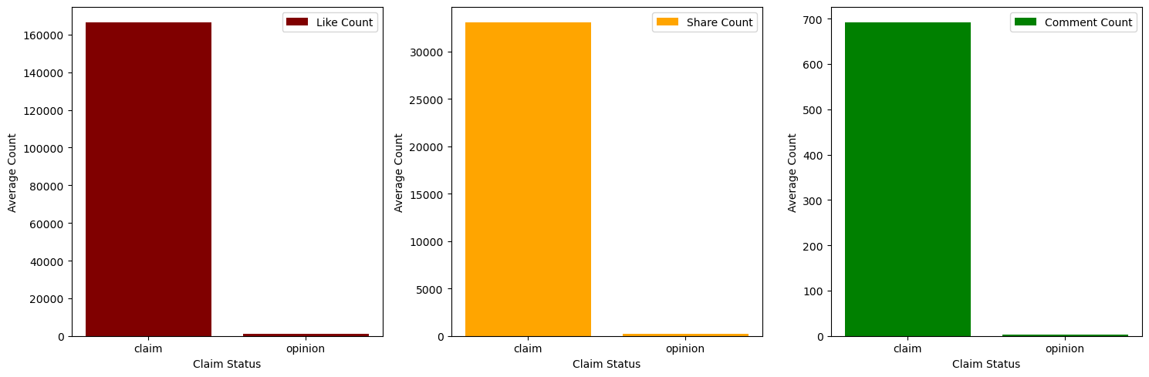
Research Question:
3. Are there differences in engagement between videos labeled as 'claim' versus 'opinion'?

Slide 33
Conclusion
1. From our analysis, we are concluding that having verified videos does not lead to success in terms of likes, shares, and comments.
2. Having more views leads to video success.
3. There is a significant difference between videos labeled as claims and opinions.
4. The end users who can potentially benefit with our analysis are creators, viewers, fans & followers, advertisers, community members, and many more.

Slide 34
Limitation & Future Work
1. Advanced Machine Learning for Prediction: Future research could integrate advanced machine learning to predict user behavior on TikTok. This includes personalized content recommendations and targeted marketing through user segmentation.
2. Dynamic Network Analysis: Utilizing dynamic network analysis will deepen our understanding of evolving user interactions, aiding in optimizing engagement strategies.
3. Cross-platform Data Integration: Exploring methods to merge TikTok user engagement data with other social media platforms' data for a comprehensive view of user behavior.
4. Ethical Priorities: Ethical considerations, such as user privacy and data protection, must remain central throughout the analysis process to maintain user trust and research integrity.

Slide 35
References
Gesmundo, M. A. G., Jordan, M. D. S., Meridor, W. H. D., Muyot, D. V., Castano, M. C. N., & Bandojo, A. J. P. (2022). TikTok as a Platform for Marketing Campaigns: the Effect of Brand Awareness and Brand Recall on the Purchase Intentions of Millennials. Journal of Business and Management Studies, 4(2), 343–361. https://doi.org/10.32996/jbms.2022.4.2.27 ‌
Salhab, H., Al-Amarneh, A., Aljabaly, S., Zoubi, M., & Othman, M. (2023). The impact of social media marketing on purchase intention: The mediating role of brand trust and image. International Journal of Data and Network Science, 7(2), 591–600. https://growingscience.com/beta/ijds/6007-the-impact-of-social-media-marketing-on-purchase-intention-the-mediating-role-of-brand-trust-and-image.html ‌
Sharabati, A.-A. A., Al-Haddad, S., Al-Khasawneh, M., Nababteh, N., Mohammad, M., & Abu Ghoush, Q. (2022). The Impact of TikTok User Satisfaction on Continuous Intention to Use the Application. Journal of Open Innovation: Technology, Market, and Complexity, 8(3), 125. https://doi.org/10.3390/joitmc8030125 ‌
Rezek, A. (2022). How Brands Go Viral: An Analysis of Successful Brand Marketing on Tik Tok with Gen Z" (2022). Honors Theses. https://egrove.olemiss.edu/cgi/viewcontent.cgi?article=3662&context=hon_thesis ‌

Slide 36
THANK YOU!
Any Questions?

